Slide 1
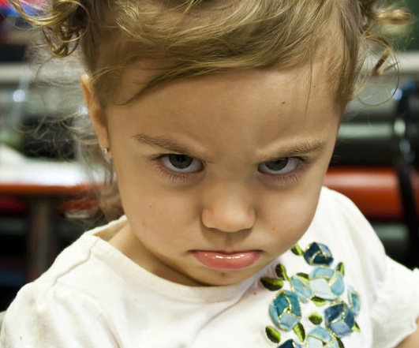
Why Physicists Hate Miracles!

Slide 2
Physics works by
Studying pattern and structure in the natural world
Extending (or summarizing) patterns in laws and theories
Applying rules of reasoning to understand and predict (control?)
Experimenting – repeating and comparing outcomes with predictions

Slide 3
Miracles or Magic?
Is there an important distinction here?
Does God need to “break the rules”?
If I need to “explain” every miracle is this not like having to explain a joke? I seem to have missed the point by the very act of explaining!
Do miracles need to “jar” us in some profound way? – Why?

Slide 4
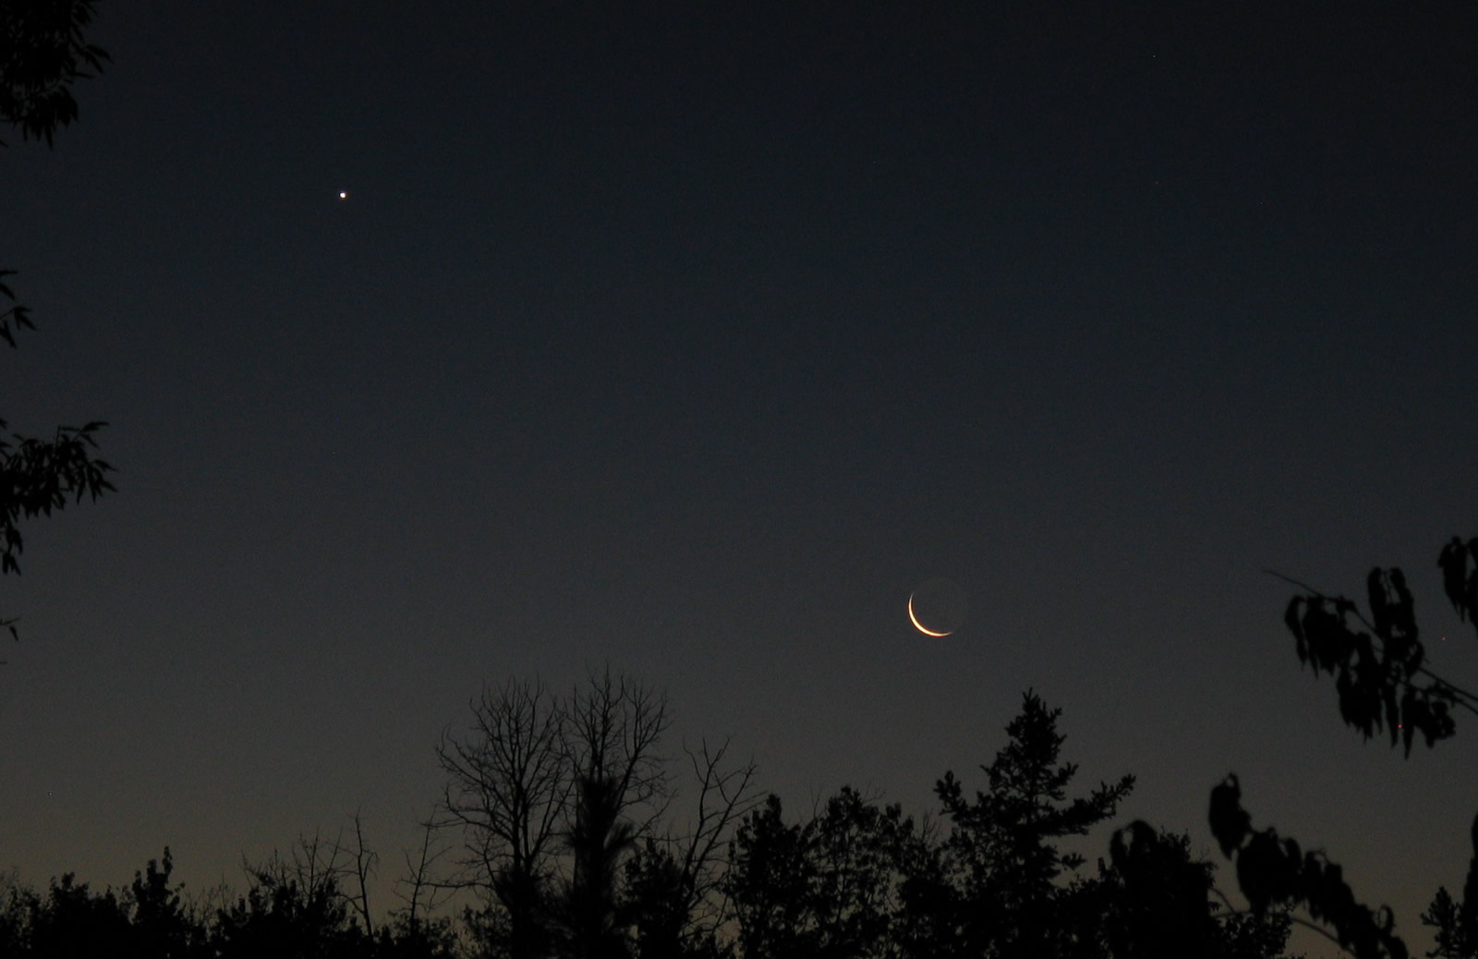
Epiphanies
… from wandering planets to wondering hearts

Slide 5
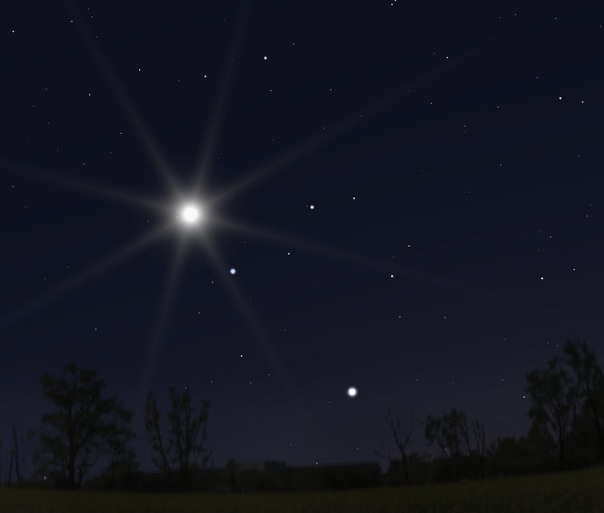
Jupiter, the King in Leo (the “King”) in the Middle Eastern sky from Fall 3 BCE to Summer 2 BCE
The sky from Judea, looking west at sunset in June 17, 2 BCE

Slide 6
Psalm 19
The heavens declare the glory of God; the skies proclaim the work of his hands. Day after day they pour forth speech; night after night they reveal knowledge. They have no speech, they use no words; no sound is heard from them. Yet their voice goes out into all the earth, their words to the ends of the world. In the heavens God has pitched a tent for the sun. It is like a bridegroom coming out of his chamber, like a champion rejoicing to run his course. It rises at one end of the heavens and makes its circuit to the other; nothing is deprived of its warmth.

Slide 7
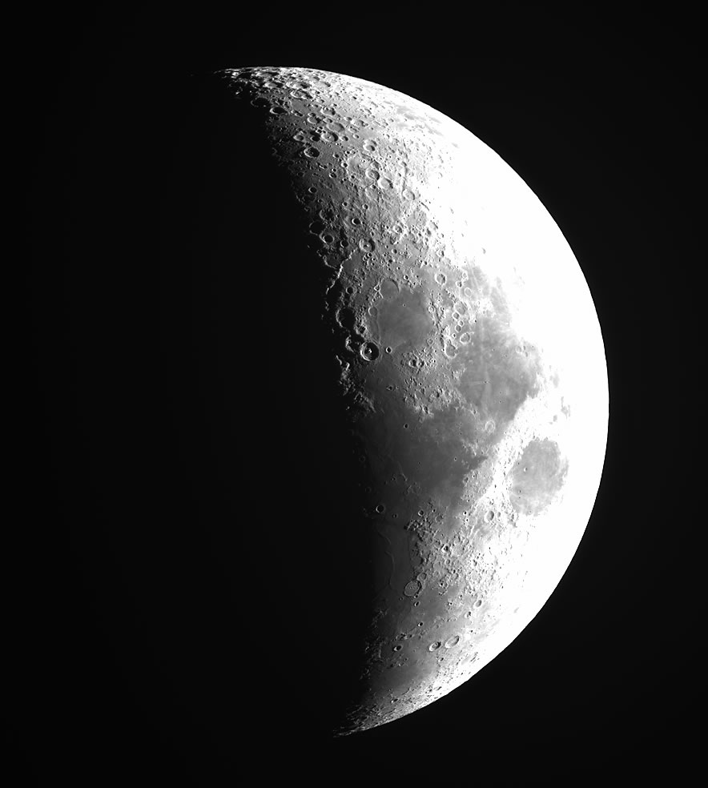

Slide 8
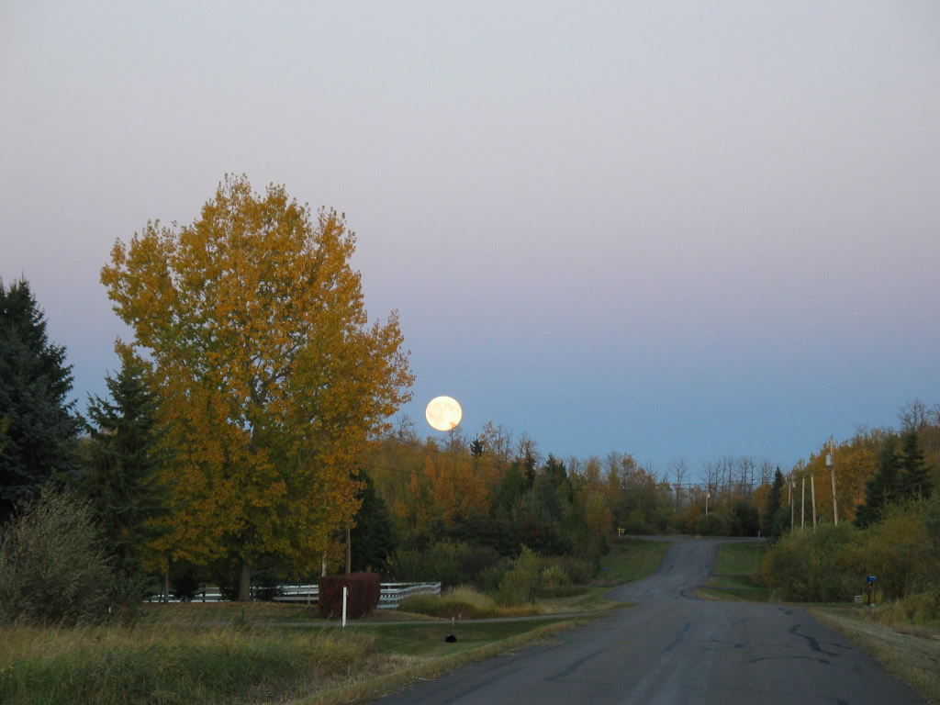

Slide 9
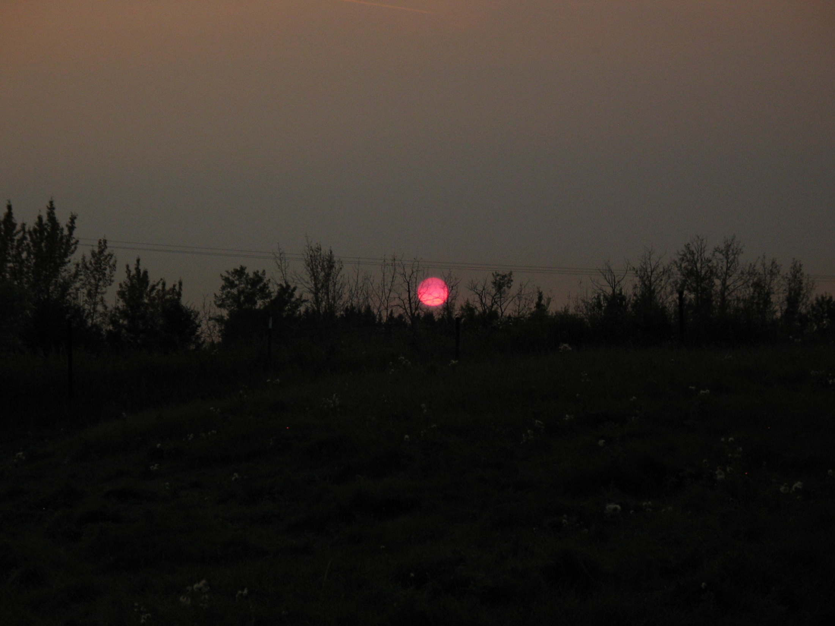
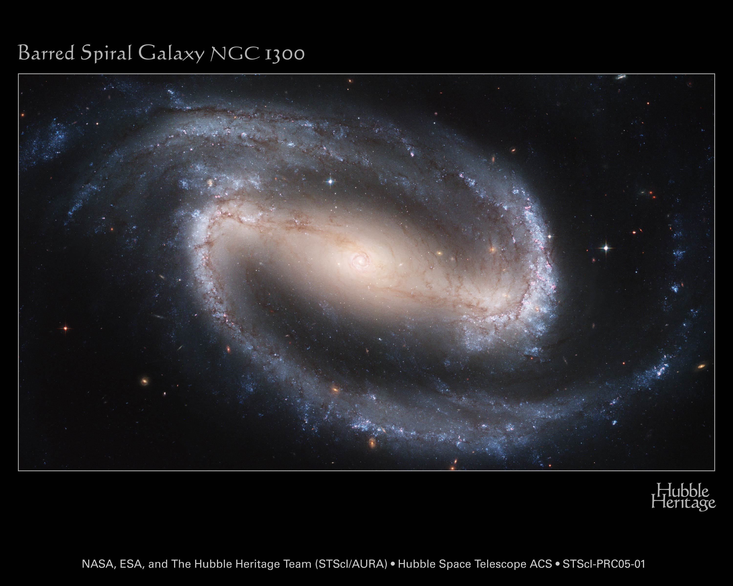

Slide 10
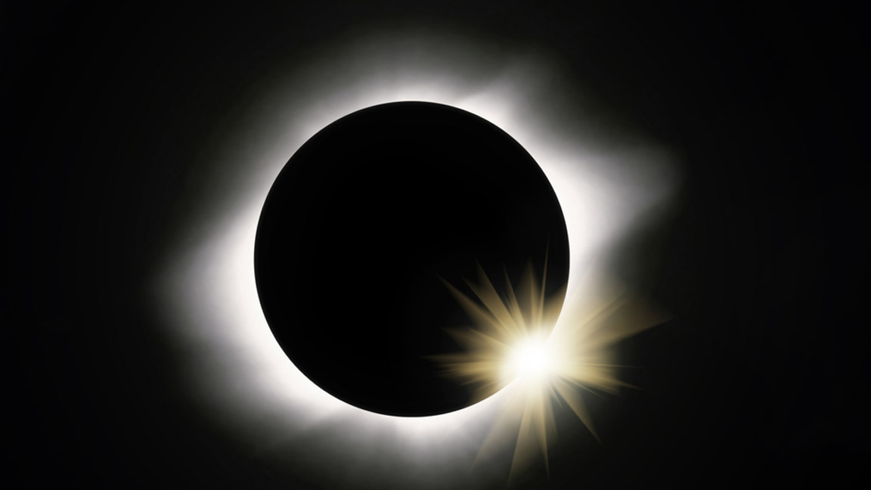

Slide 11
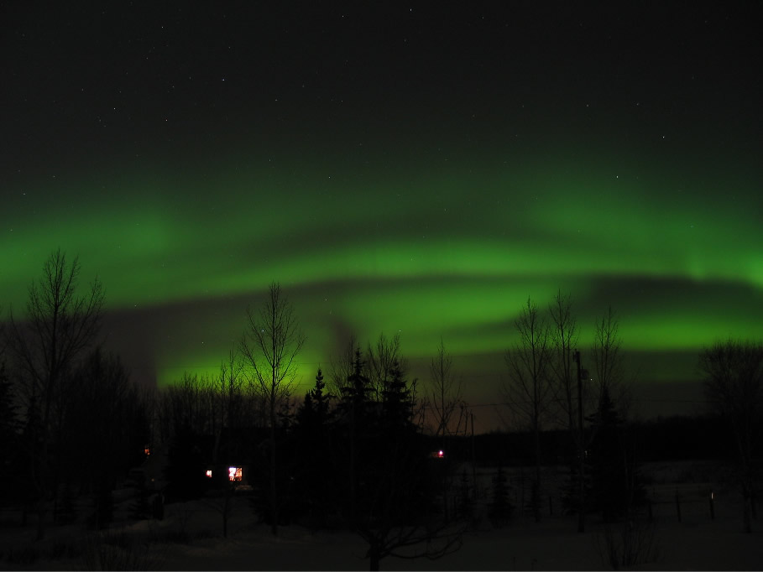

Slide 12
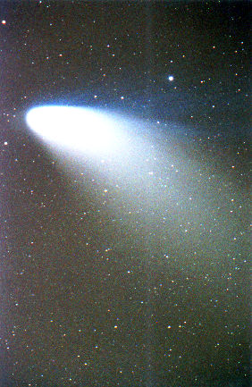
The Meteorite
Among the hills a meteorite Lies huge; and moss has overgrown, And wind and rain with touches light Made soft, the contours of the stone. Thus easily can Earth digest A cinder of sidereal fire, And make her translunary guest The native of an English shire. Nor is it strange these wanderers Find in her lap their fitting place, For every particle that's hers Came at the first from outer space. All that is Earth has once been sky; Down from the sun of old she came, Or from some star that travelled by Too close to his entangling flame. Hence, if belated drops yet fall From heaven, on these her plastic power Still works as once it worked on all The glad rush of the golden shower. C S Lewis

Slide 13
I believe a leaf of grass is no less than the journey work of the stars,
And the pismire is equally perfect, and a grain of sand, and the egg of the wren,
And the tree-toad is a chef-d'oeuvre for the highest,
And the running blackberry would adorn the parlors of heaven,
And the narrowest hinge in my hand puts to scorn all machinery,
And the cow crunching with depress'd head surpasses any statue,
And a mouse is miracle enough to stagger sextillions of infidels.
Walt Whitman, Leaves of Grass (31)

Slide 14
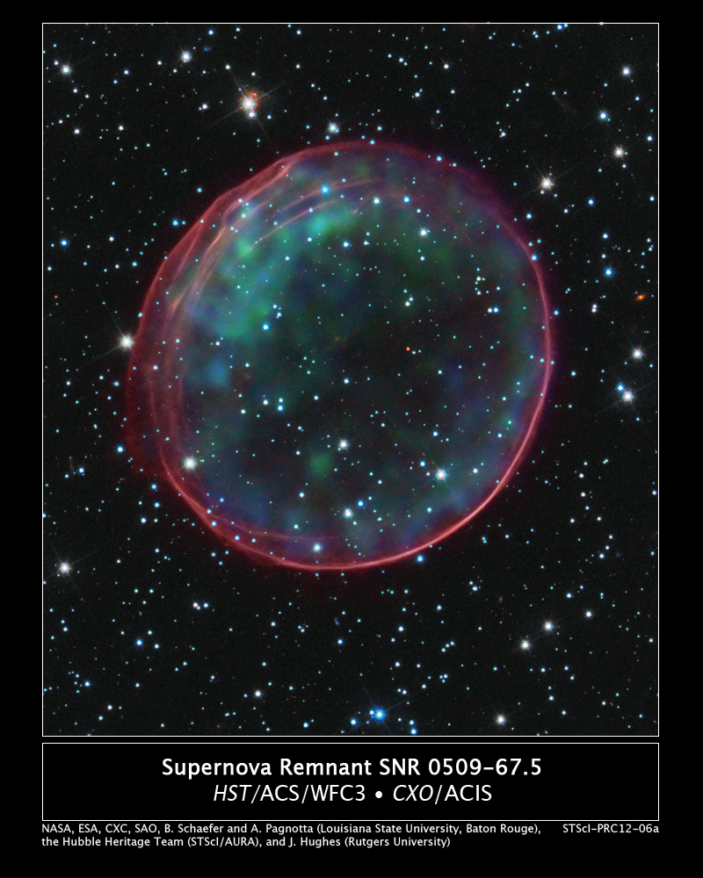

Slide 15
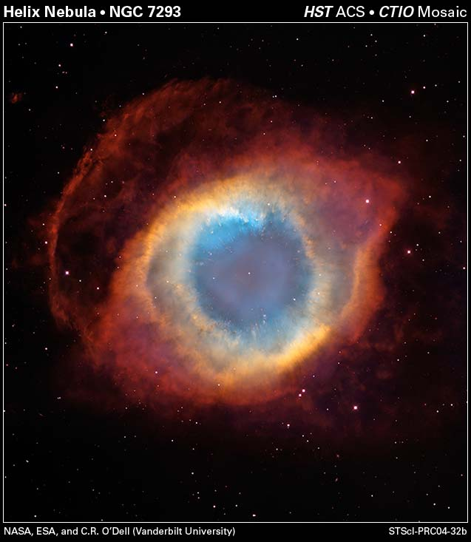

Slide 16
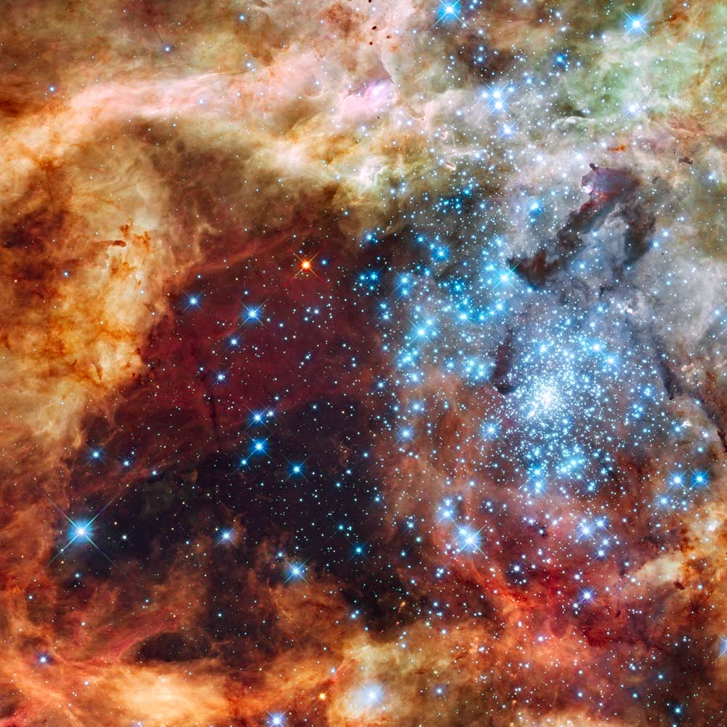

Slide 17
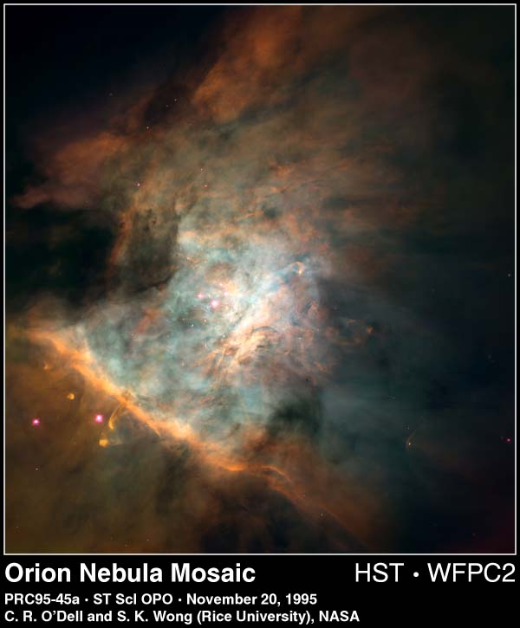

Slide 18
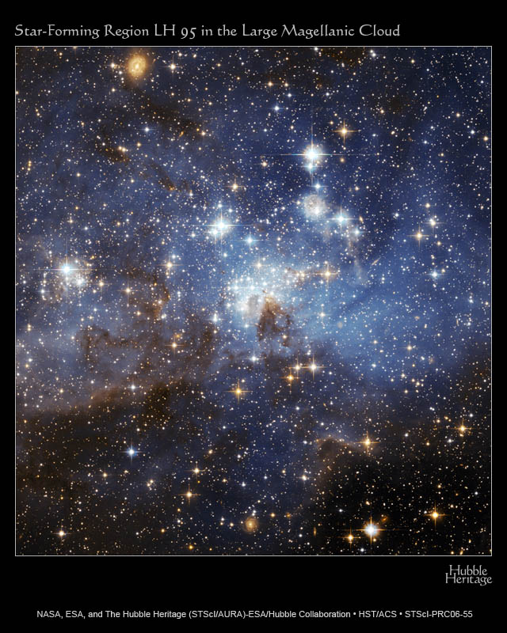

Slide 19
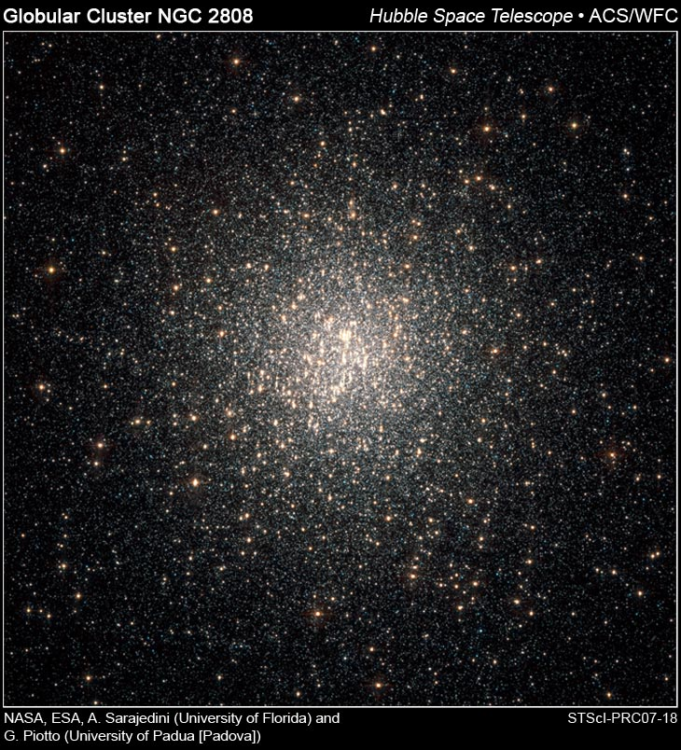

Slide 20
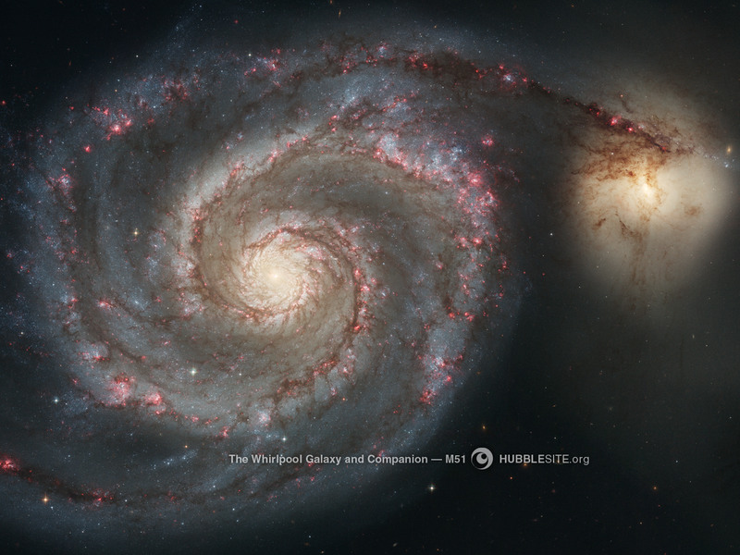

Slide 21
